Slide 1

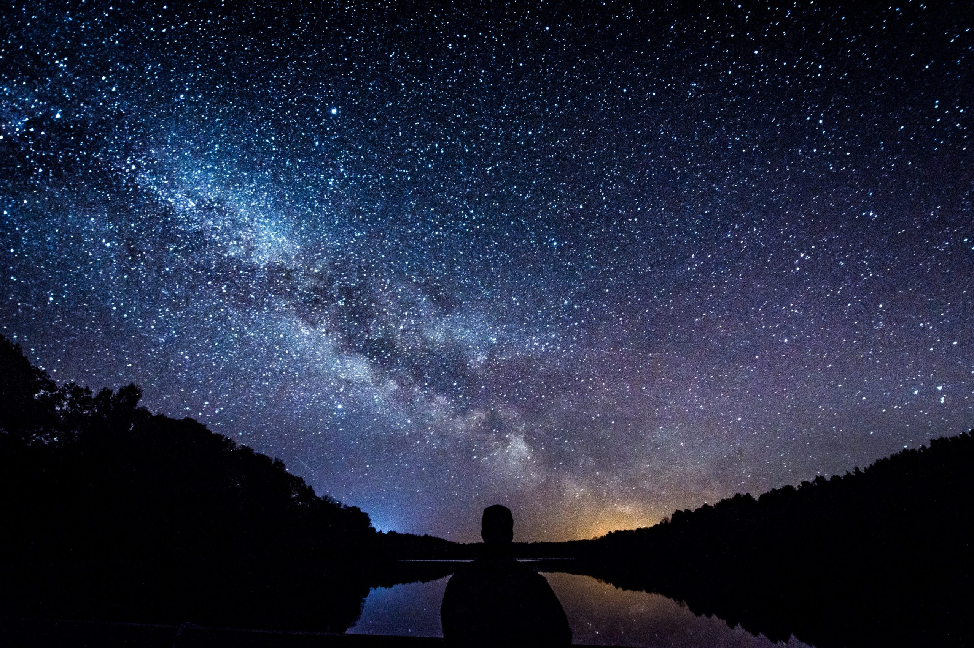
Team 209 Polaris
Team 209
Polaris

Slide 2
TABLE OF CONTENTS
01
02
03
THE PROBLEM
THE PATH
THE DESTINATION
Families and friends apart - The effects of COVID 19.
How can we reunite people using space data and international news.
This is Polaris.
The end of the journey.

Slide 3

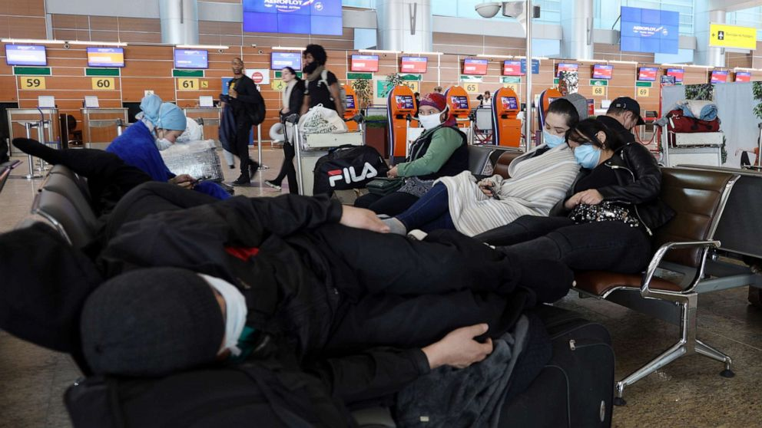
Families Apart
THE PROBLEM
Coronavirus disease (COVID-19) is an infectious disease caused by a newly discovered coronavirus. COVID-19 pandemic required governments to take measures to restrict mobility. Closed borders, restrictions on flights and strict activities control.
Although necessary, these measures created a new problem: Thousands of people were unable to travel and, therefore, unable to return home.The lack of information spreads doubts, insecurity and other negative feelings among travelers.

Slide 4
THE PATH
Space Data
News
SATURN
NEPTUNE
Application
Data provided by NASA, JAXA and other sources of information.
In to go market terms, we are covering and has a go to market feasibility due to the lack of the specific feature in travel websites and news website.
This will help people to plan and at least be aware of when they will be able to review their loved ones, based on predictions with data analysis
Polaris 209 will use as much data as is useful for a user to get a sense of how that region, city, state or nation (based on the search it does) is dealing with Covid-19 and how dangerous it would be to travel to that place.
Political acts in regions like full lockdown, population moviment percentil of risk and the possible date of estabelization of the virus
Saturn is the ringed one. It’s a gas giant, composed of hydrogen and helium. It’s named after the Roman god of agriculture
Neptune is the farthest planet from the Sun, the fourth-largest in our Solar System and also the densest

Slide 5
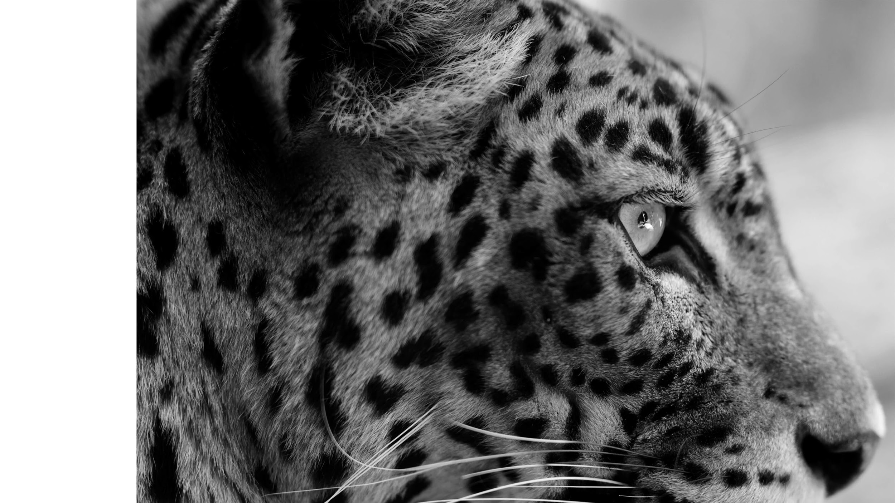

03
THE DESTINATION

